Slide 1
Use Cases and Solutions for Multi-Agent Authorization
Chunchi Peter Liu，Yuan Ni
IETF 126, Vienna

Slide 2
Cross-Domain Task Context Propagation
Batch Authorization Delegation

Slide 3
Cross-Domain Task Context Propagation
Batch Authorization Delegation

Slide 4
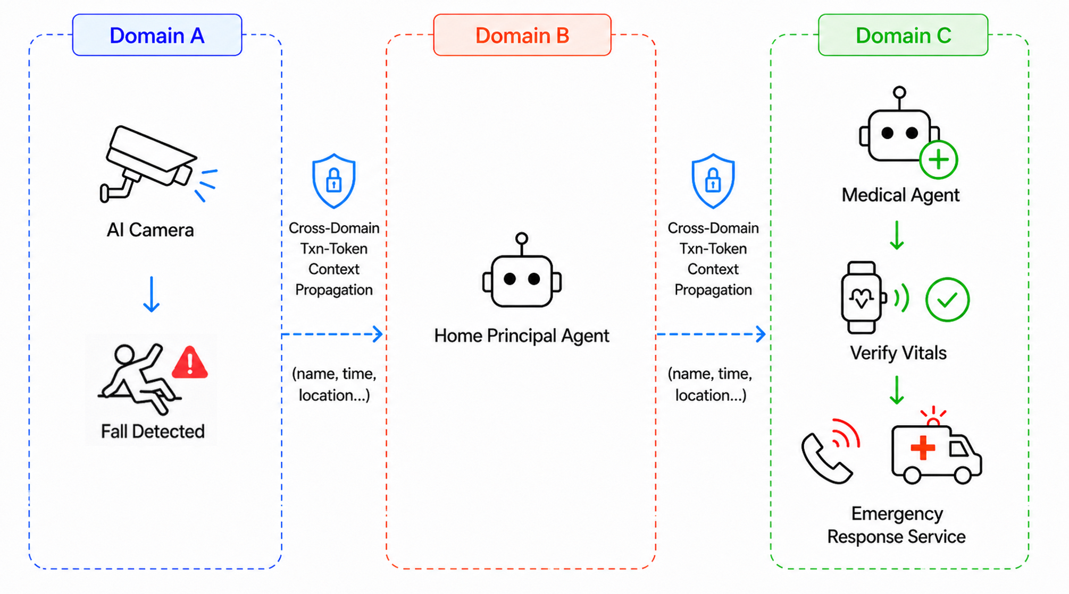
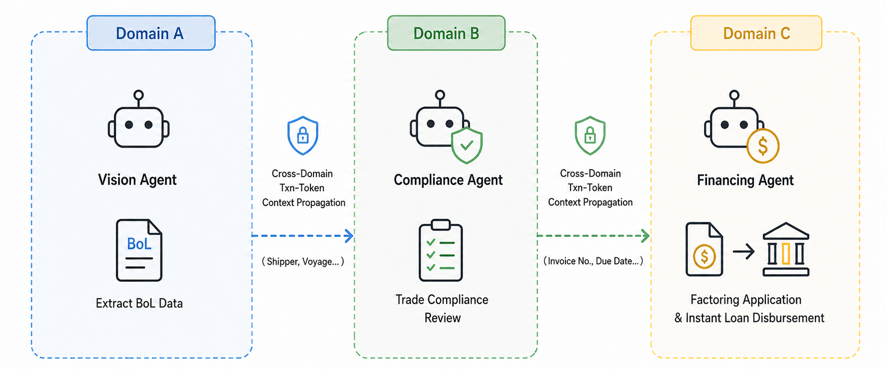
Cross-Domain Task Context Propagation—Use Cases
Background：
Internet of Agents presents a vision of an open ecosystem where agents and other resources (services, tools, etc. ) cooperate across different domains. (Supporters: Anthropic, Cisco, Google, Huawei, Tencent……
During this process, preserving Cross-Domain Task Context during propagation becomes necessary.
Use cases: both of the cases below need cross-domain resource collaboration.
Agent-Driven Emergency Response:
AI camera detects an elderly fall
-> Home principal agent assesses and invokes a Medical Agent
-> Medical Agent verifies vital signs via wearable devices and
invokes an Emergency Response Service
Cross-Border Agent-Driven Supply Chain Finance:
Vision Agent extracts BoL data
-> Compliance Agent runs trade compliance review
-> Financing Agent submits factoring application and executes
instant loan disbursement.

Slide 5
Cross-Domain Task Context Propagation—Gap
Existing Building Blocks:
Drafts | What It Does | Limitation
Txn-Token [I-D.ietf-oauth-transaction-tokens] | Preserves user identity, workload identity, authz context (txn, tctx, rctx, req_wl) within a single domain | Complete data model defined.
Identity Chaining [I-D.ietf-oauth-identity-chaining] | Enables cross-domain identity and authorization propagation via JAGs | Cross-domain transport mechanism defined.
GAP：Need design for Encapsulate Txn-Token contexts (txn, tctx, rctx, req_wl) into JAGs of Identity Chaining.
Both blocks are mature; ONLY need to combine them!

Slide 6
Cross-Domain Task Context Propagation— Two solutions
Both works build on Identity Chaining + Txn-Token.
Drafts | Txn-Token JAG Profile draft-fletcher-transaction-token-chaining-profile | Cross-Domain Txn Token（our draft） draft-liu-oauth-cross-domain-txn-token
Flow | Txn-Token → JAG → Access Token (3 RTTs) | Mode A：Txn-Token 1 -> JAG -> Access Token -> Txn-Token 2 Same as JAG Profile. Direct composition of Identity Chaining + Txn-Token. Minimal changes.
 |  | Mode B ：Txn-Token 1 -> JAG -> Txn-Token 2 (1 RTTs) JAG directly exchanged for Txn-Token. Saves 2 RTTs. Scalable. Requires extension that allow TTS to accept JAG as subject_token.
Claims | txn (pass, immutable) tctx (do not pass) rctx (pass, minimized) req_wl (do not pass) | txn (pass, immutable) tctx (pass, minimized) rctx (pass, minimized) req_wl (pass, each hop appended, minimized)
Data Minimization: AS MAY remove/redact claims (tctx, rctx, req_wl) not needed downstream; log locally if audit required.

Slide 7
Cross-Domain Task Context Propagation
Batch Authorization Delegation

Slide 8
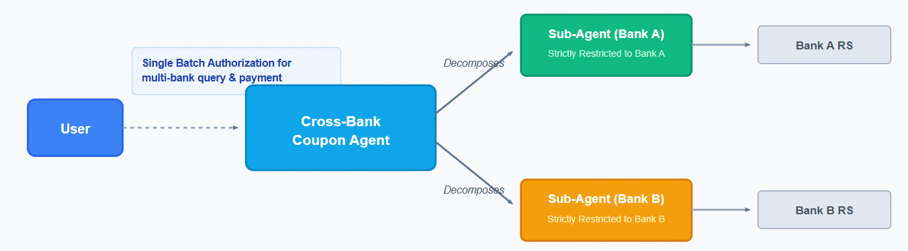
Batch Authorization Delegation—Use Case
Scenario：Since a task may consists of a batch of sub-tasks and requires a batch of authorization to different resources, a new resource access scenario appears:
Sub-Agent 1
Resource 1
A leader-agent (eg. a principal personal assistant AI Agent) coordinates multiple sub-agents to complete a task.
User
Leader-Agent
Sub-Agent 2
Resource 2
Sub-Agent 3
Resource 3
Use Case：
A cross-bank Coupon Agent can coordinate multiple bank-specific sub-agents to calculate the best discount from all of the user’s bank accounts for a single payment.
Core Challenge:
One-Time Batch Authorization (to avoid repeated user interations) + Downscoped Delegation (to ensure each sub-agent accesses ONLY its resource)

Slide 9
Batch Authorization Delegation—Gap
What Existing OAuth Standards Provide?
OAuth 2.0 Rich Authorization Request （RAR） [RFC9396]
OAuth 2.0 Token Exchange [RFC8693]
Defines the only actor via the may_act claim.
Defines authorization_details for requesting a batch of fine-grained permissions
Sub-Agent 1
Resource 1
User
Leader-Agent
Sub-Agent 2
Resource 2
Sub-Agent 3
Resource 3
Gap:
RAR enables one-time batch authorization of permissions, but cannot bind the permissions to different designated actors.
Token Exchange enables delegation, but cannot express which subset of permissions is delegated to which actor.

Slide 10
Batch Authorization Delegation—Our Solution
Add may_act Delegation to Each Downstream Sub-agent
OAuth 2.0 Token Exchange [RFC8693] | This draft
Leader agent can only delegate the permission to A. | Leader agent can delegate one permission to A; and delegate another permission to B; ……
"aud": "https://issuer.example.com",
"iss": "https://issuer.example.com",
"sub": "user@example.com",
"client_id": "leader_agent@example.com",
"authorization_details": [
{ "type": "flight_booking",
"actions": ["search", "book"],
"locations": ["https://example.com/flights"],
"may_act": {"sub": "flight_agent@example.com" // A}},
{ "type": "hotel_reservation",
"actions": ["search", "book"],
"locations": ["https://example.com/hotels"],
"may_act": { "sub": "hotel_agent@example.com" // B}}]
"aud": "https://consumer.example.com",
"iss": "https://issuer.example.com",
"sub": "user@example.com",
"client_id": "leader_agent@example.com",
"scope": "status feed",
"may_act": { "sub": "admin@example.com" // A}

